Slide 1

Lab: Week 12
DATA403(00)
(Reinforcement Learning)

Slide 2
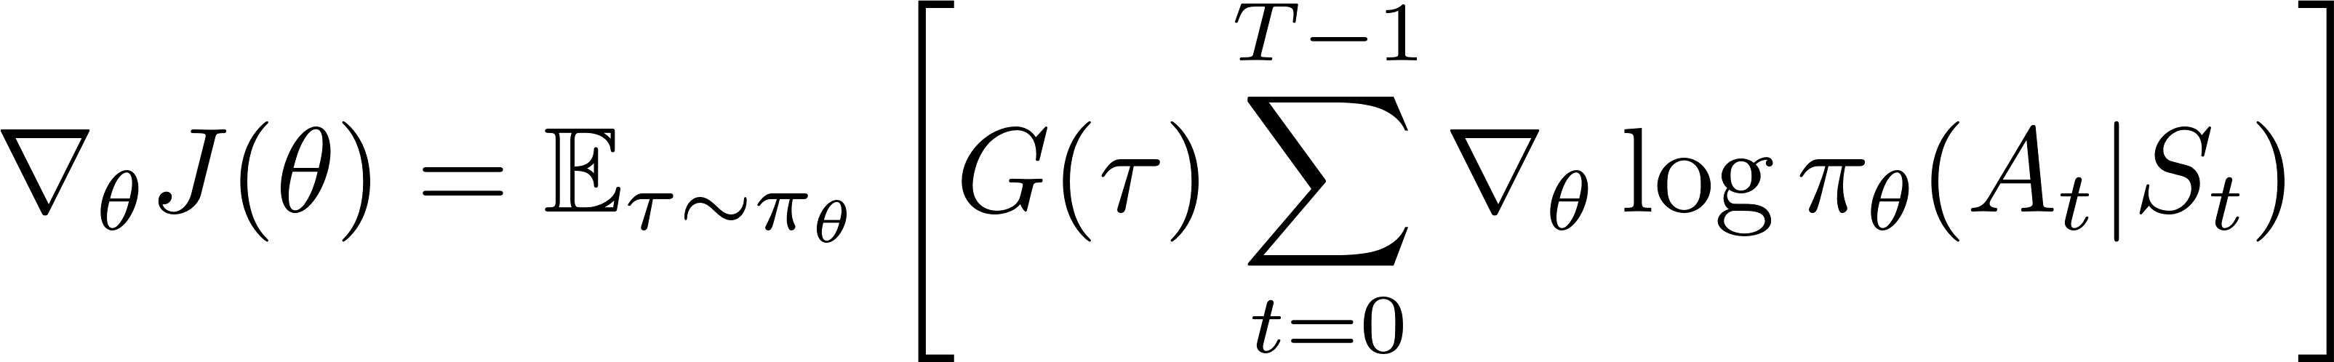

Policy-based DRL
Space of parameter $θ$
Characteristics:
Policy = neural network, policy gradient to optimize
Stochastic policy is admitted
Basic policy gradient equation:
For today’s lab: REINFORCE and Actor-Critic
REINFORCE = PG + Monte Carlo prediction
Actor-Critic
Will be done in following lab sessions…
DDPG (Deep Deterministic Policy Gradient)
TD3 (Twin-Delayed DDPG)
SAC (Soft Actor-Critic)
PPO (Proximal Policy Optimization)

Slide 3
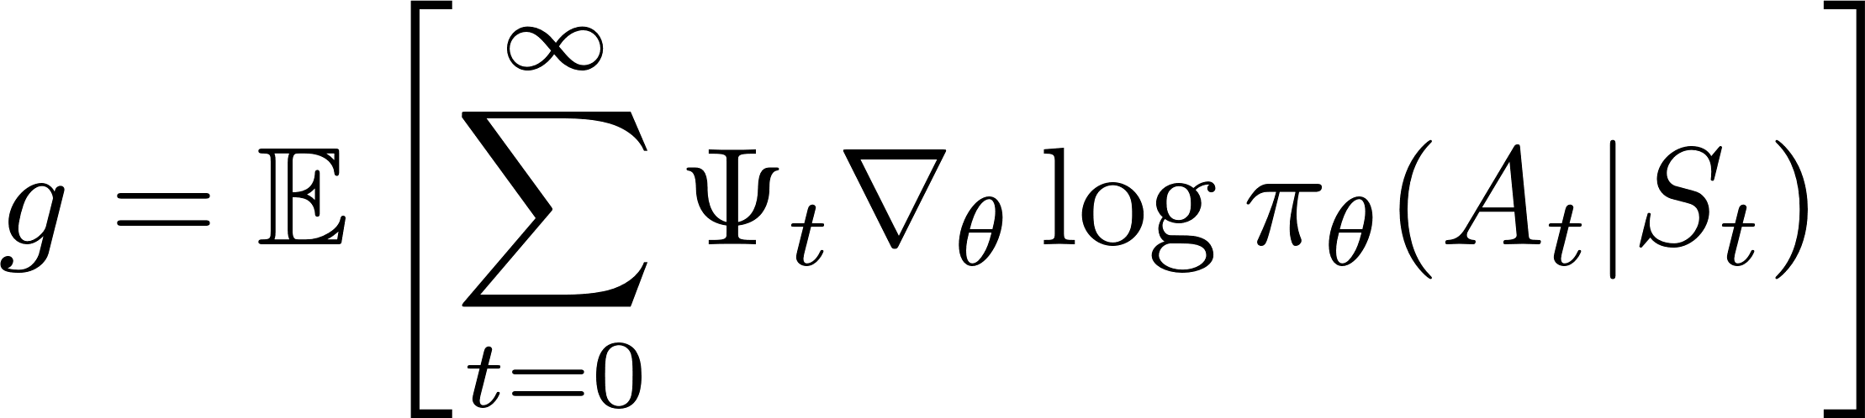
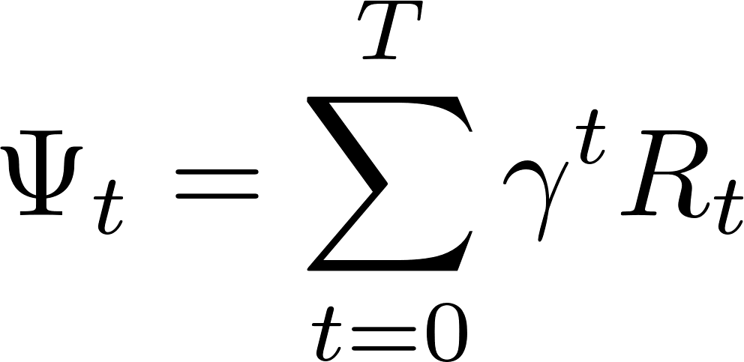
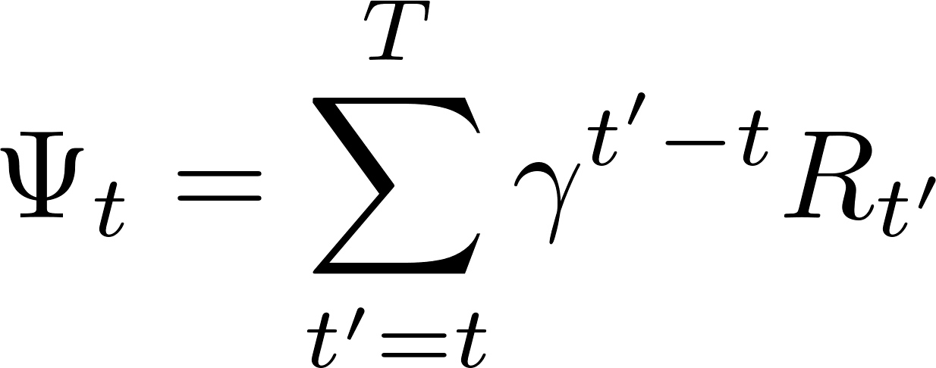
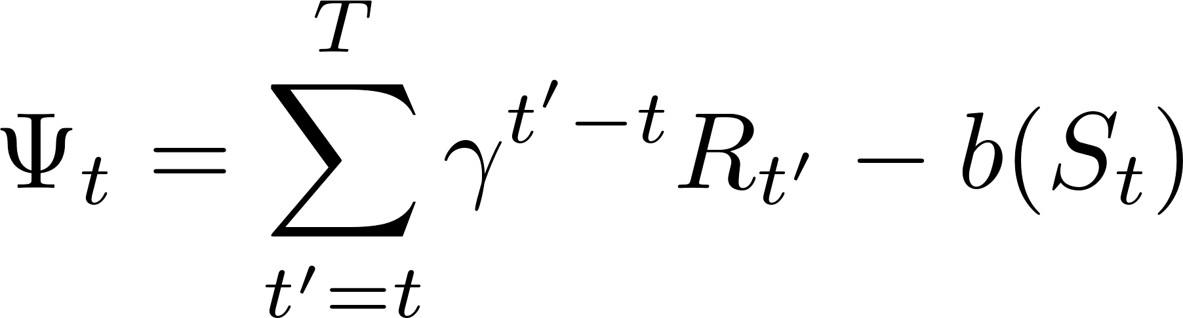

Today’s Algorithm
Recall Generalized Advantage Estimation (GAE)
Consider a class of gradient:
$Ψ_{t}$ can be…
Total return
REINFORCE
REINFORCE with baseline
REINFORCE:
Vanilla PG:
Actor-Critic:

Slide 4
Installing Box2D in Windows
Follow the instructions
Download swigwin-*.zip (any version… maybe)
https://sourceforge.net/projects/swig/files/
Unzip & place the folder at any place you want
Set system variable
Setting > system variable (설정 > 시스템 환경 변수 편집)
System variable > Path > edit (시스템 변수 > Path > 편집)
Make new (새로 만들기) > type swigwin folder path (C:/…)
Now this will work…
pip install gymnasium[box2d]
Helpful blog (KOR): https://mclearninglab.tistory.com/136

Slide 5
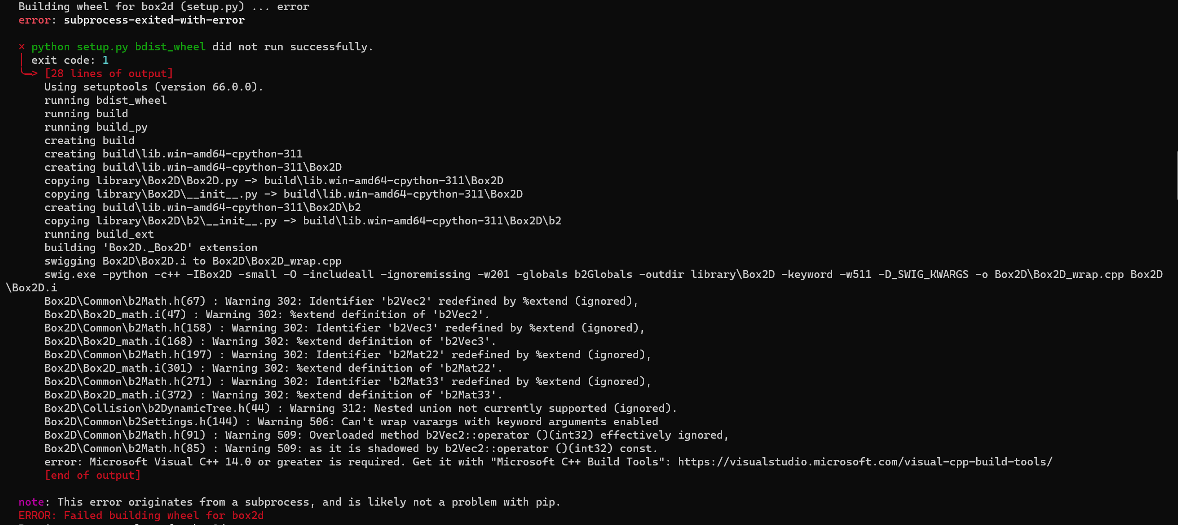
If you are facing this error…
Click this link & install
Take some time…

Slide 6
Open Notebook Files
REINFORCE first,
Then Actor-Critic

